Slide 1
Numeric Data Types and Operators
Chapter 2 – Part 3

Slide 2
Numeric Data Types (1 of 7)
The information that is stored and manipulated by computers programs is referred to as data.
There are two different kinds of numbers!
(5, 3, 5, 7) are whole numbers – they don’t have a fractional part
(.25, .10, .05, .01) are decimal fractions

Slide 3
Numeric Data Types (2 of 7)
Inside the computer, whole numbers and decimal fractions are represented quite differently!
We say that decimal fractions and whole numbers are two different data types.
The data type of an object determines what values it can have and what operations can be performed on it.

Slide 4
Numeric Data Types (3 of 7)
Whole numbers are represented using the integer (int for short) data type.
These values can be positive or negative whole numbers.

Slide 5
Numeric Data Types (4 of 7)
Numbers that can have fractional parts are represented as floating point (or float) values.
How can we tell which is which?
A numeric literal without a decimal point produces an int value
A literal that has a decimal point is represented by a float (even if the fractional part is 0)

Slide 6
Numeric Data Types (5 of 7)
Python has a special function to tell us the data type of any value.
>>> type(3)
<class 'int'>
>>> type(3.1)
<class 'float'>
>>> type(3.0)
<class 'float'>
>>> myInt = 32
>>> type(myInt)
<class 'int'>
>>>

Slide 7
Numeric Data Type (6 of 7)
Why do we need two number types?
Values that represent counts can’t be fractional (you can’t have 3 ½ quarters)
Most mathematical algorithms are very efficient with integers
The float type stores only an approximation to the real number being represented !
Since floats aren’t exact, use an int whenever possible!

Slide 8
Numeric Data Types (7 of 7)
Operations on ints produce ints, operations on floats produce floats (except for /).
>>> 3.0+4.0
7.0
>>> 3+4
7
>>> 3.0*4.0
12.0
>>> 3*4
12
>>> 10.0/3.0
3.3333333333333335
>>> 10/3
3.3333333333333335
>>> 10 // 3
3
>>> 10.0 // 3.0
3.0

Slide 9
Type Conversions (1 of 3)
We know that combining an int with an int produces an int, and combining a float with a float produces a float.
What happens when you mix an int and float in an expression?
x = 5.0 + 2
What do you think should happen?

Slide 10
Type Conversions (2 of 3)
If one of the operands for the numeric operators is a float value, the result will be a float value.
In mixed – typed expressions Python will convert ints to floats.
Sometimes we want to control the type conversion. This is called explicit typing.

Slide 11
Type Conversions (3 of 3)
>>> float(22//5)
4.0
>>> int(4.5)
4
>>> int(3.9)
3
>>> round(3.9)
4
>>> round(3)
3

Slide 12
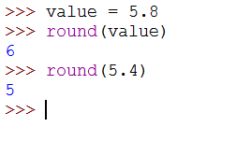
The round Function
We can use the round function to round a number to the nearest whole value.

Slide 13
Numeric Operators
Name | Meaning | Example | Result | Precedence
+ | Addition | 34 + 1 | 35 | 3
- | Subtraction | 34.0 – 0.1 | 33.9 | 3
* | Multiplication | 300*30 | 9000 | 2
/ | Float Division | ½ | 0.5 | 2
// | Integer Division | 1//2 | 0 | 2
** | Exponentiation | 4 ** 0.5 | 2.0 | 1
% | Remainder/modulus | 20 % 3 | 2 | 2
Note: You can use parentheses to override the order of precedence. Operations within parentheses are always performed before operations outside parentheses.

Slide 14
Numeric Operators
The / operator performs a float division that results in a floating number.
>>> 4 / 2
2.0
The // operator performs an integer division; the result is an integer, and any fractional part is truncated.
>>> 5 // 2
2
The ** operator computes a with an exponent of b for any numbers a and b.
>>> (-2.5) ** 2
6.25
The % operator yields the remainder after division.
>>> 7 % 3
1

Slide 15
Numeric Operator Precedence
Exponential (**) is applied first.
Multiplication (*), float division(/), integer division (//), and remainder operators (%) are applied next. If an expression contains several multiplication, division, and remainder operators, they are applied from left to right.
Addition (+) and subtraction (-) operators are applied last. If an expression contains several addition and subtraction operators, they are applied from left to right.

Slide 16
Grouping with Parentheses
Parts of a mathematical expression may be grouped with parentheses to force some operations to be performed before others.
In the following statement, the variables x and y are added together, and their sum is divided by 5:
result = (x + y) / 5

Slide 17
The remainder/modulus (%) Operator
The int modulus (%) operator performs integer division, and returning only the remainder.
Example:
34 % 5 = 4 //because 34 divided by 5 has a remainder of 4.

Slide 18
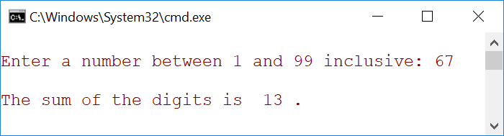
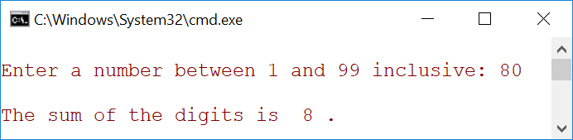
Summing the digits in an integer program
Question: Write a program that reads an integer between 1 and 99 inclusive, and adds the digits in the integer. For example, if an integer is 93, the sum of its digits is: 9 + 3 = 12. For now, you will not worry about the situation where the input integer is out of range. You will assume that the user enters an integer is between 1 and 99.

Slide 19
Getting the rightmost digit in a positive integer
Assume that a positive integer x that has already been declared. Getting the remainder of x divided by 10 leaves you with the right most digit:
x % 10
Example:
x = 45
y = 45 % 10 // y = 5 , the right most digit of x

Slide 20
Removing the rightmost digit from an integer
Assume that an integer x that has been declared, to remove the rightmost digit, you can do the division:
x / 10
Example:
x = 45
y = 45 / 10
// y = 4, the rightmost digit of x has been removed

Slide 21
Formatting Numbers and Strings
Often it is desirable to display numbers in certain format.
The format function formats a number or a string and returns a string.
format(item, format-specifier)

Slide 22
Formatting Floating-point Numbers
Note: If the number is longer than the width, the format function returns the string representation for the number.
For example, format(25.2445, “0.2f”) → 25.24

Slide 23
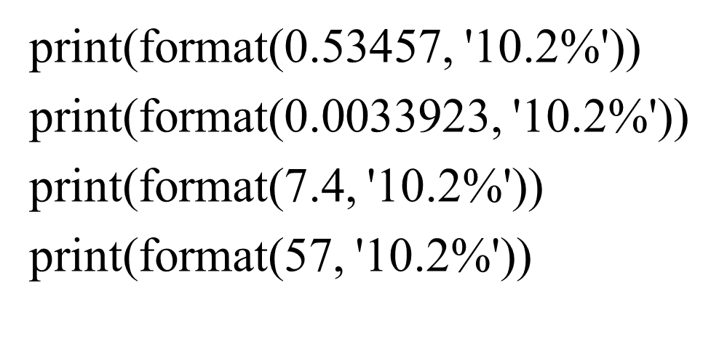
Formatting as a Percentage
You can use the conversion code % to format a number as a percentage.

Slide 24
Augmented Assignment Operators
Operator | Name | Example | Equivalent
+= | Addition | x += 8 | x = x +8
-= | Subtraction | x -= 8 | x = x - 8
*= | Multiplication | x *= 8 | x = x * 8
/= | Float Division | x /= 8 | x = x / 8
//= | Integer Division | x //= 8 | x = x // 8
%= | Remainder | x %= 8 | x = x % 8
**= | Exponent | x **= 8 | x = x ** 8
Caution: There are no space in the augmented assignment operators. For example, + = should be +=.

Slide 25
Some of Python’s escape characters
Escape Character | Effect
\n | Causes output to be advanced to the next line.
\t | Cause output to skip over to the next horizontal tab position
\’ | Cause a single quote mark to be printed.
\” | Cause a double quote mark to be printed.
\\ | Cause a backslash character to be printed.

Slide 26
Breaking Long Statements into Multiple Lines
Long statements cannot be viewed on screen without scrolling and cannot be printed without cutting off.
Multiline continuation character (\) allows to break a statement into multiple lines.
Example:
print(“my first name is”, \
first_name)

Slide 27
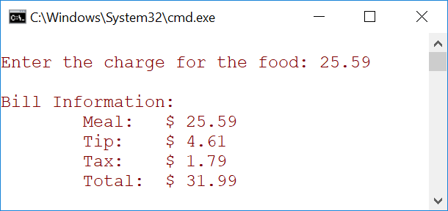
Tip, Tax, and Total Program
Question: write a program that calculates the total amount of a meal purchased at a restaurant. The program should ask the user to enter the charge for the food, and then calculate the amount of a 18 percent tip and 7 percent sales tax. Display each of these amounts and the total.

Slide 28
Programming Errors
Syntax Errors – Python has its own syntax, and you need to write code that obey the syntax rules. If your program violates the rules, Python will report syntax errors.
Runtime Errors – They occur while a program is running if the Python interpreter detects an operation that is impossible to carry out. Input mistakes typically cause runtime errors.
Logic Errors – They occur when a program does not perform the way it was intended to. Errors of this kind occur for many different reasons.

